Slide 1
Experimental Design For Engineers
ISYE435-535

Slide 2
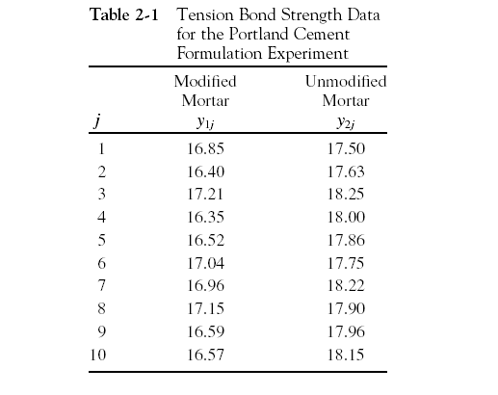
Portland Cement Formulation
Notes:
Two different formulations of cement mortar. The engineer already realized there was a reduction of the cure time for the modified formulation. Therefore he starts focusing on the strength. We have 10 different samples of both formulation: modified and unmodified. The presence of fluctuations or noise or statistical error means the response variable “strength” is a random variable.

Slide 3
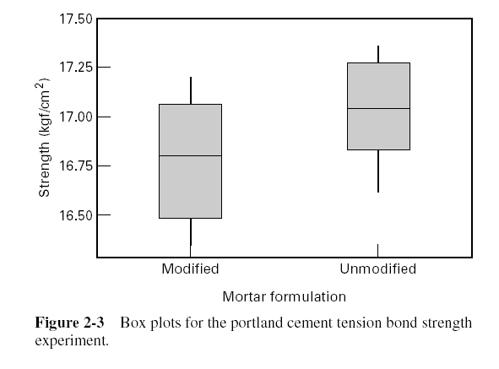
Data Description
Box plot

Slide 4
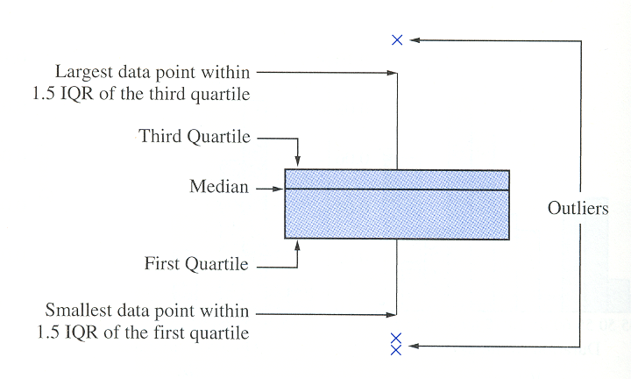
Data Description (Cont.)
Anatomy of a boxplot

Slide 5
Data Description (Cont.)
Other techniques
Normal Probability Plot
Histograms
IQR/s ratio
  If this ratio ~ 1.3 data might come from a normal distribution

Slide 6
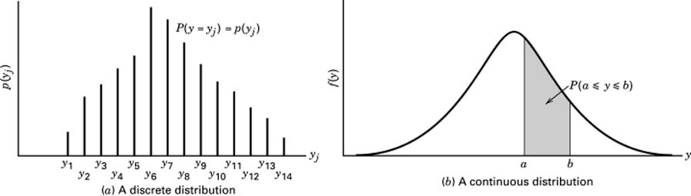
Probability Distributions

Slide 7
Probability Distributions (Cont.)
Properties

Slide 8
Mean and Variances

Slide 9
Sampling and Sampling Distributions
Sample Mean:
Sample Variance:
Sample standard deviation is the square root of the sample variance.
These statistics–or estimators–are unbiased ( ) and with minimum variance.

Slide 10
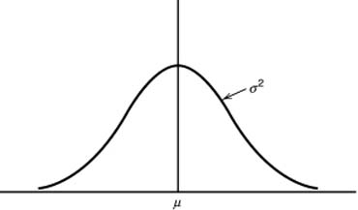
Sampling Distributions
Normal distribution N(μ,σ²)
f(x)
x

Slide 11
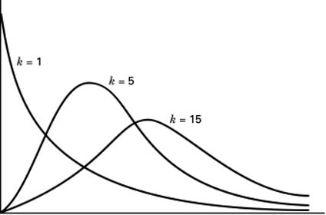
Sampling Distributions (cont.)
Chi-square or χ² distributions
  i.e., sum of k variables z ~ NID(0,1)
f(x)
x

Slide 12
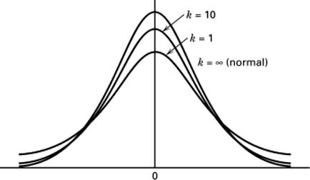
Sampling Distributions (cont.)
t-distribution with k degree of freedom
f(x)
x

Slide 13
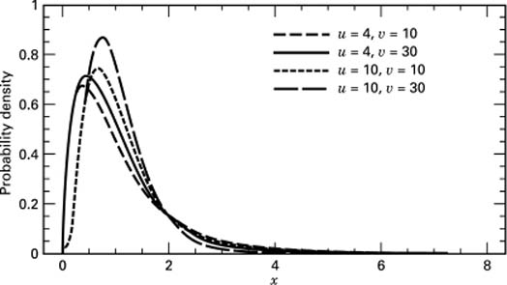
Sampling Distributions (cont.)
F distribution with k degree of freedom

Slide 14
The Hypothesis Testing Framework
Statistical hypothesis testing is a useful framework for many experimental situations
We will use a procedure known as the two-sample t-test

Slide 15
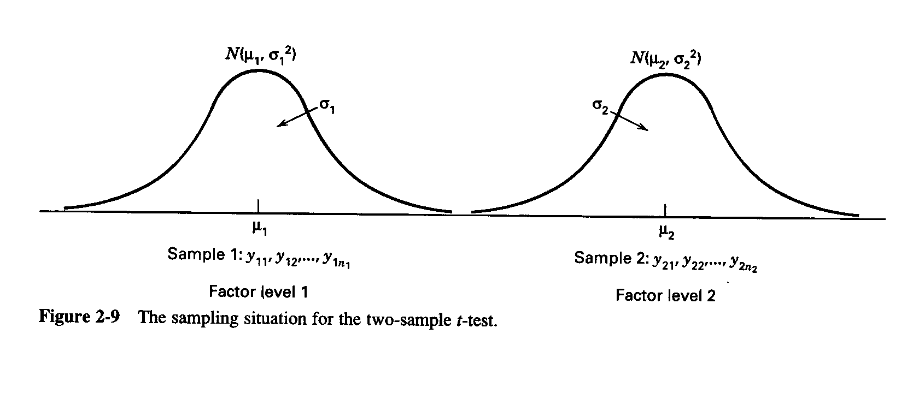
The Hypothesis Testing Framework
Sampling from a normal distribution
Statistical hypotheses:

Slide 16
Estimation of Parameters

Slide 17
Summary Statistics
Formulation 1
“New recipe”
Formulation 2
“Original recipe”

Slide 18
How the Two-Sample t-Test Works:
Values of t₀ that are near zero are consistent with null hypothesis
Values of t₀ that are very different from zero are consistent with alternative hypothesis
t₀ is a “distance” measure-how far apart the averages are expressed in standard deviation units
Notice the interpretation of t₀ as a signal-to-noise ratio

Slide 19
How the Two-Sample t-Test Works:

Slide 20
The Two-Sample (Pooled) t-Test

Slide 21
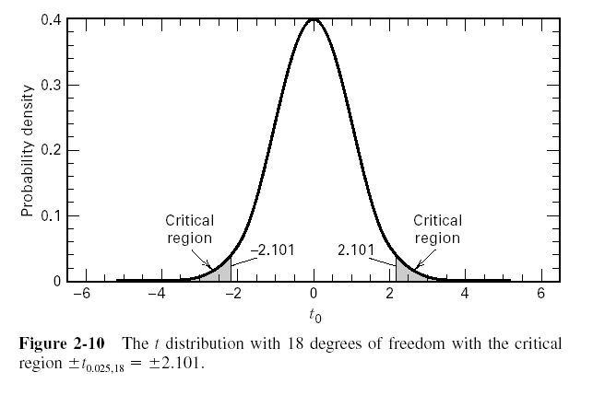
The Two-Sample (Pooled) t-Test
So far, we haven’t really done any “statistics”
We need an objective basis for deciding how large the test statistic t₀ really is
In 1908, W. S. Gosset derived the reference distribution for t₀ … called the t distribution
Tables of the t distribution - text, page 606
t₀ = -2.20

Slide 22
The Two-Sample (Pooled) t-Test
A value of t₀ between –2.101 and 2.101 is consistent with equality of means
It is possible for the means to be equal and t₀ to exceed either 2.101 or –2.101, but it would be a “rare event” … leads to the conclusion that the means are different
Could also use the P-value approach
t₀ = -2.20

Slide 23
The Two-Sample (Pooled) t-Test
t₀ = -2.20
The P-value is the risk of wrongly rejecting the null hypothesis of equal means (it measures rareness of the event)
The P-value in our problem is P = 0.042

Slide 24
Importance of the t-Test
Provides an objective framework for simple comparative experiments
Could be used to test all relevant hypotheses in a two-level factorial design, because all of these hypotheses involve the mean response at one “side” of the cube versus the mean response at the opposite “side” of the cube

Slide 25
Confidence Intervals
Hypothesis testing gives an objective statement concerning the difference in means, but it doesn’t specify “how different” they are
General form of a confidence interval
The 100(1- α)% confidence interval on the difference in two means:

Slide 26
Summary
(Mendenhall &Sincich, Stat. for Eng. and Sciences, Prentice Hall,1995)
Confidence interval for difference of means, when samples are large.

Slide 27
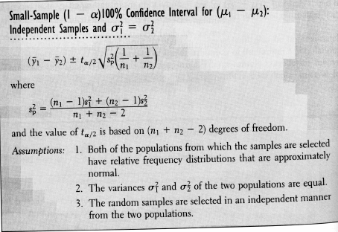
Summary (cont.)
Confidence interval for difference of means, when samples are small.

Slide 28
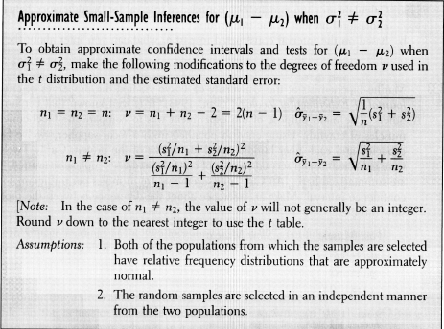
Summary (cont.)
Confidence interval for difference of means, when samples are small.

Slide 29
Summary (cont.)
Confidence interval for difference of means, when we use match pairs.

Slide 30
Summary (cont.)
Confidence interval for variance.

Slide 31
Summary (cont.)
Confidence interval for difference of means, when we use match pairs.

